Slide 1
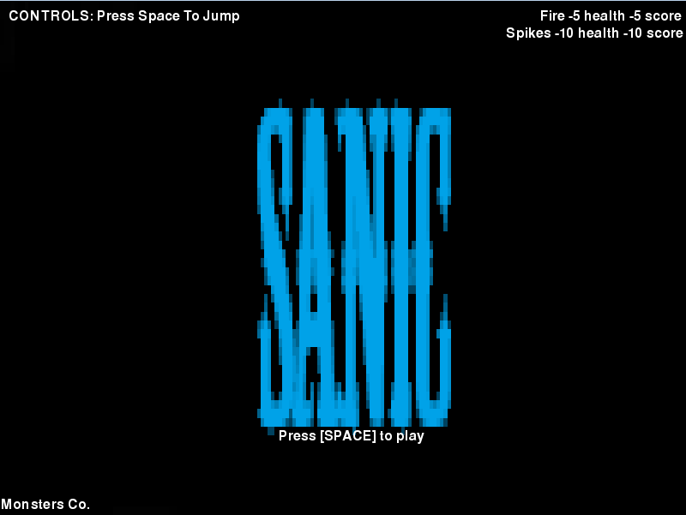
Notes:
Welcome to our game!

Slide 2
Notes:
The type of game is a side scrolled, platform game

Slide 3
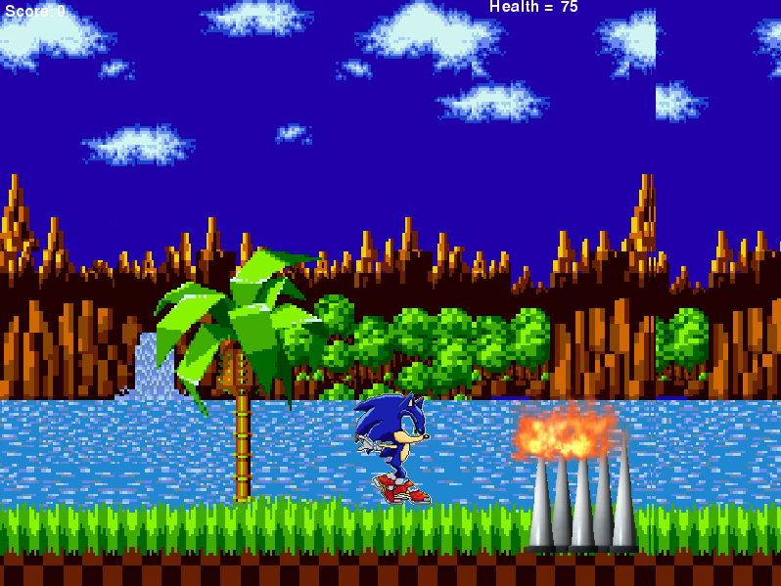
Notes:
Spikes And Fire will hurt you. Avoid them!

Slide 4
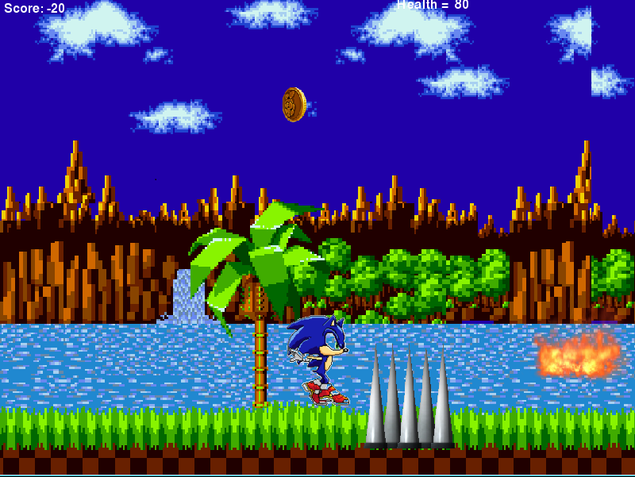
Notes:
The objective of the game is that the character must survive this infinite runner game, without dying by losing all your health. There are many obstacles going to be included to try to kill the character from reaching a high score. There will be rings to help increase the time. Rings would be used as a form of additional score points, but if your character dies you will have to restart the level.

Slide 5
